Slide 2
Vulnerability and Control Deficiency Analysis
  Vulnerabilities are weaknesses, gaps or holes in an enterprise people, processes or technologies that provide an opportunity for a threat actor to exploit, which create consequences that may impact the enterprise.
  The National Institute of Standards and Technology (NIST) Special Publication 800-30 Revision 1: Guide to Conducting Risk Assessments provides a list of vulnerabilities to consider.
  Many vulnerabilities are conditions that exist in systems and must be identified so that they can be addressed.
  The purpose of vulnerability identification is to find the problems before they are found by an adversary and exploited.
  This is why an enterprise should conduct regular vulnerability assessments and penetration tests to identify, validate and classify its vulnerabilities.
  Where vulnerabilities exist, there is a potential for risk.

Slide 3
Note: Other sources of vulnerabilities include:
  National Vulnerability Database at nvd.nist.gov
  Common Weakness Enumeration at nvd.nist gov/vuln/eategories
  Common Vulnerabilities and Exposures at eve.mitre.org
  Exploit Database at exploit-db.com
  The Community Driven Vulnerability Database at vulndb.org
  Vulnerability Database Catalog at www. first.org/global/sigs/vrdx/vdb-catalog
  Packet Storm Security at packetstormsecurity.com
  Rapid7 Vulnerability and Exploit Database at rapid7.com/db
  CXSecurity Free Vulnerability Database at cxsecurity.com/exploit!
  Vulnerability Lab at vulnerability-lab.com
  Oday-today at www-.0day.today
  Harmonized Threat and Risk Assesment at www.ese-cst.ge.ca
  Open Web Application Security Project (OWASP) at www.owasp.org

Slide 4
Sources of Vulnerabilities
  Vulnerabilities can be found in most places within and external to the enterprise. Sources of vulnerabilities are discussed in the following sections.
Network Vulnerabilities
  Network vulnerabilities are often related to misconfiguration of equipment, poor architecture or traffic interception.
  Misconfiguration is a common problem with network equipment that is not properly installed, operated or maintained.
  Any open services are a potential attack vector that can be exploited by an attacker, so network equipment should be hardened by disabling any unneeded services, ports or protocols.

Slide 5
Physical Access
  Physical security goes far beyond theft.
  Threat agents that are able to gain physical access to systems have the potential to bypass nearly every other type of control.
  With access to server rooms, network cabling, information systems equipment and buildings, an attacker can circumvent passwords, install skimmer to intercept data communications and take logical ownership of systems or devices.
  With more than 20 percent of incidents related to misuse of systems by insiders who may already have an advantage in terms of gaining physical access, the need for strong physical security is clear and growing.
  Testing for physical security vulnerabilities include testing access control systems, testing locks, security guards, fire suppression systems, heating ventilation and air conditioning controls, lighting, cameras, motion sensors and physical entrance.
  over the last few years, physical security concerns are still very valid and are a reliable method for gaining initial access to an environment (figure 2.9).

Slide 6
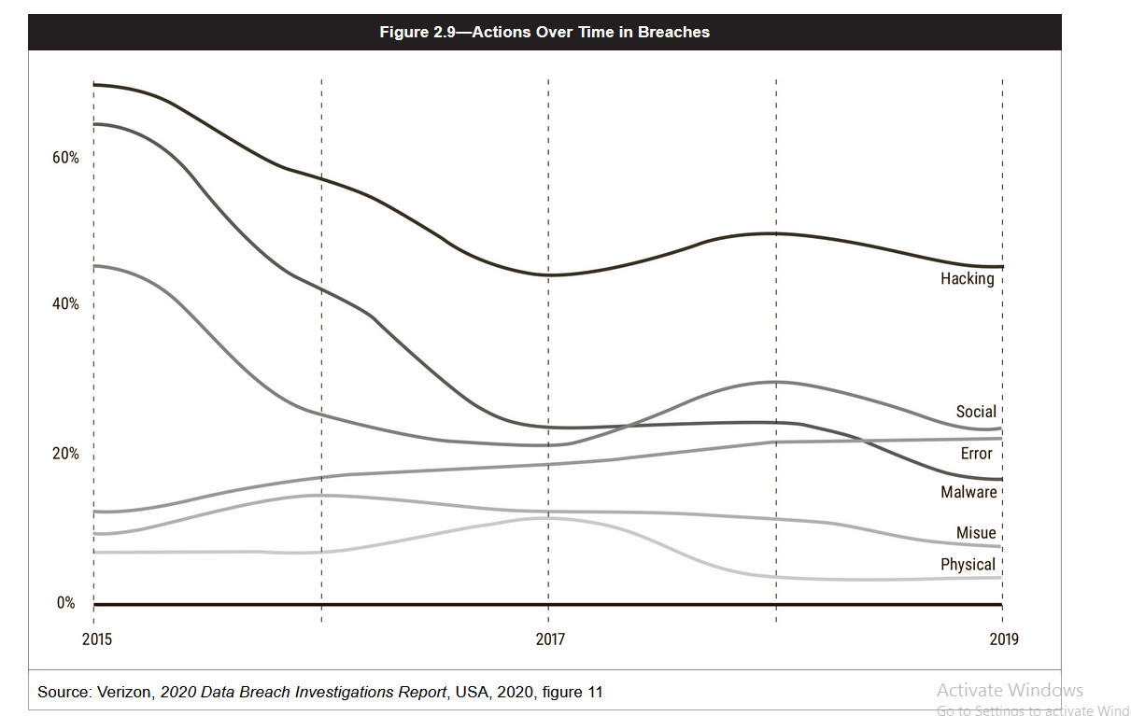

Slide 7
Applications and Web-facing Services
  Applications in general, web applications in particular, are among the most common entry points currently used by attackers.
  Many applications are written to support business function without due regard to the security requirements of the applications and may be vulnerable to buffer overflows, logic flaws, injection attacks, bugs, incorrect control over user access and many other common vulnerabilities.
  The risk practitioner can use tools from the Open Web Application Security Project (OWASP)? to test web-facing applications for well-known and documented vulnerabilities whose presence can lead to data compromise or system failure.
Utilities
  Information systems rely on controlled environmental conditions, including clean and steady power and controls over humidity and temperature.
  The risk practitioner should ensure that the enterprise is prepared for power failure or other environmental conditions in order to avert conditions that may lead to system failure.
  Having an uninterruptible power supply (UPS), backup generators and surge protectors can protect equipment from damage or failure

Slide 8
Supply Chain
  Many enterprises rely on products, raw materials and supplies that originate from various locations around the world, and any interruption in the supply chain may affect their ability to function.
  For example, a shortage in supply of fuel to an airport would impact all flight operations.
  Reliance upon a supply chain should be documented even if it is understood that the risk is one that is accepted by senior management.
Equipment
  As equipment ages, it becomes less efficient, effective and potentially unable to support business functions.
  Equipment is often provided at the time of production with a mean time between failure (MTBF) rating that indicates its anticipated life span and when it should be scheduled for removal or replacement.
  There are multiple threats that older equipment can pose to enterprises, and each needs to be investigated and considered in the full context of the business value provided and benefits yielded.

Slide 9
Cloud Computing
The US National Institute of Standards and Technology (NIST) defines cloud computing as a model for enabling convenient, on-demand network access to a shared pool of configurable computing resources (e.g., networks, servers, storage, applications, and services) that can be rapidly provisioned and released with minimal management effort
The five essential characteristics of the cloud include:
  On-demand self-service” Computing capabilities can be provisioned without human interaction from the service provider.
  Broad network access” Computing capabilities are available over the network and can be accessed by diverse client platforms.
  Resource pooling” Computer resources are pooled to support a multitenant model.
  Elasticity” Resources can scale up or down rapidly and, in some cases, automatically, in response to business demands.
  Measured service” Resource utilization can be optimized by leveraging charge-per-use capabilities.

Slide 10
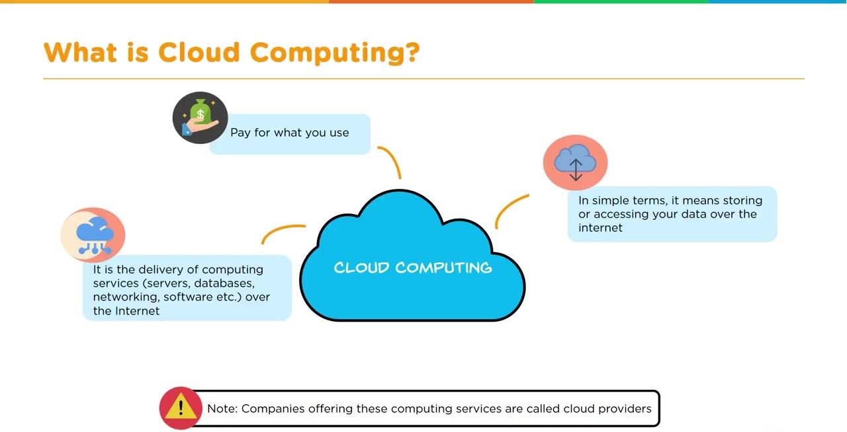

Slide 11
A cloud sourcing model can be thought of as being composed of three primary service models (figure 2.3) and four deployment models (figure 2.4).
As cloud services have evolved, a variety of other services and permutations have become available.
Overall risk and benefits differ per model, so when enterprises consider different types of service and. deployment models, they should consider the risk that accompanies them.
It should be noted that a large variety of services, platforms and software are currently available under each of areas.

Slide 12
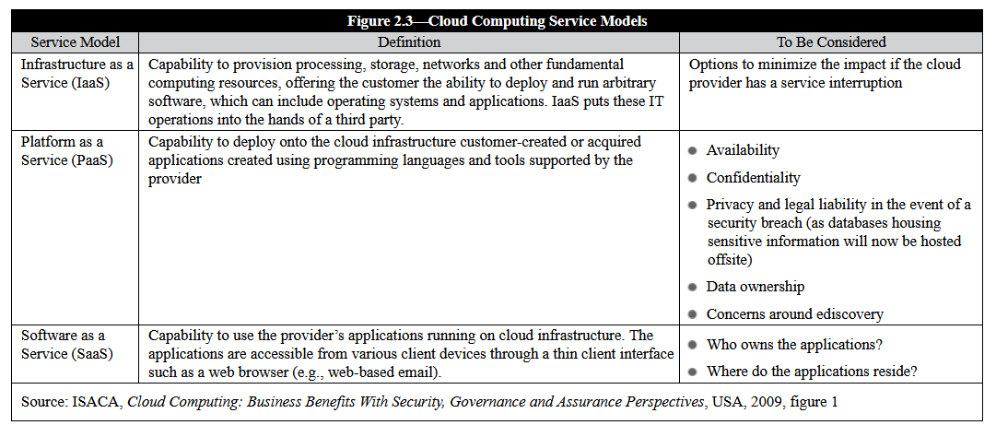

Slide 13
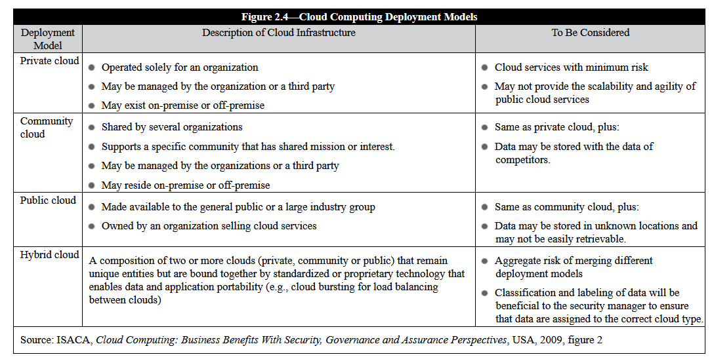

Slide 14
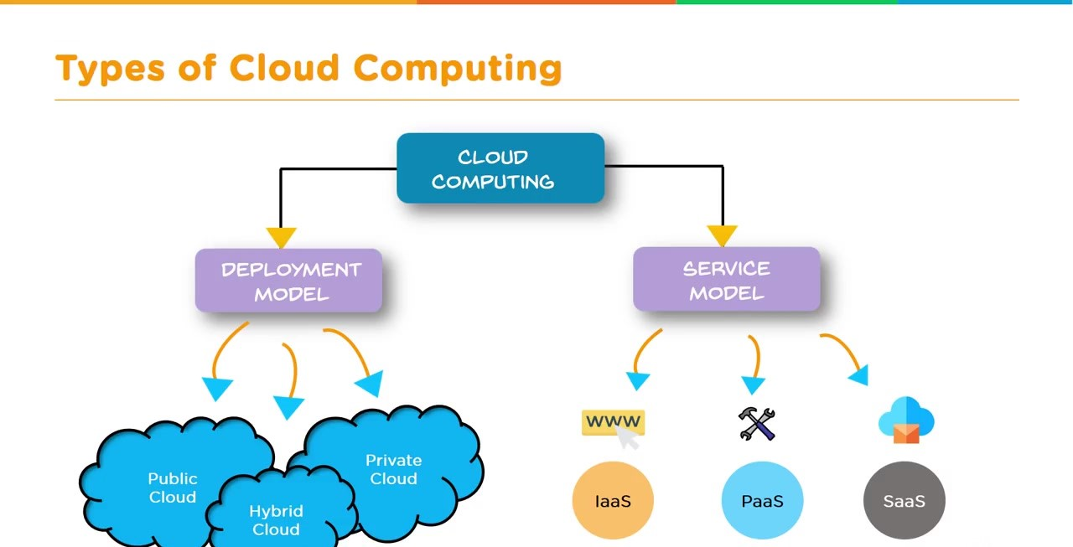

Slide 15
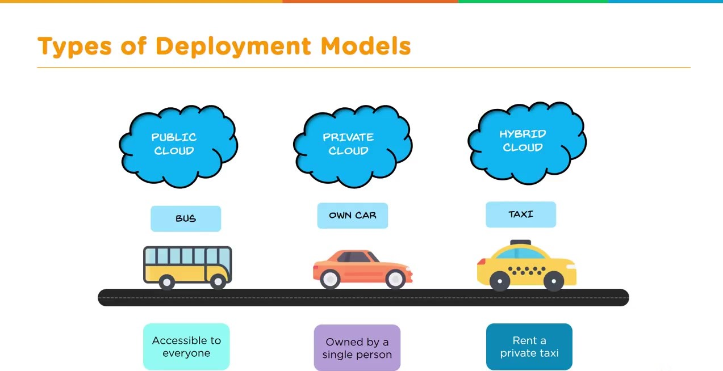

Slide 16
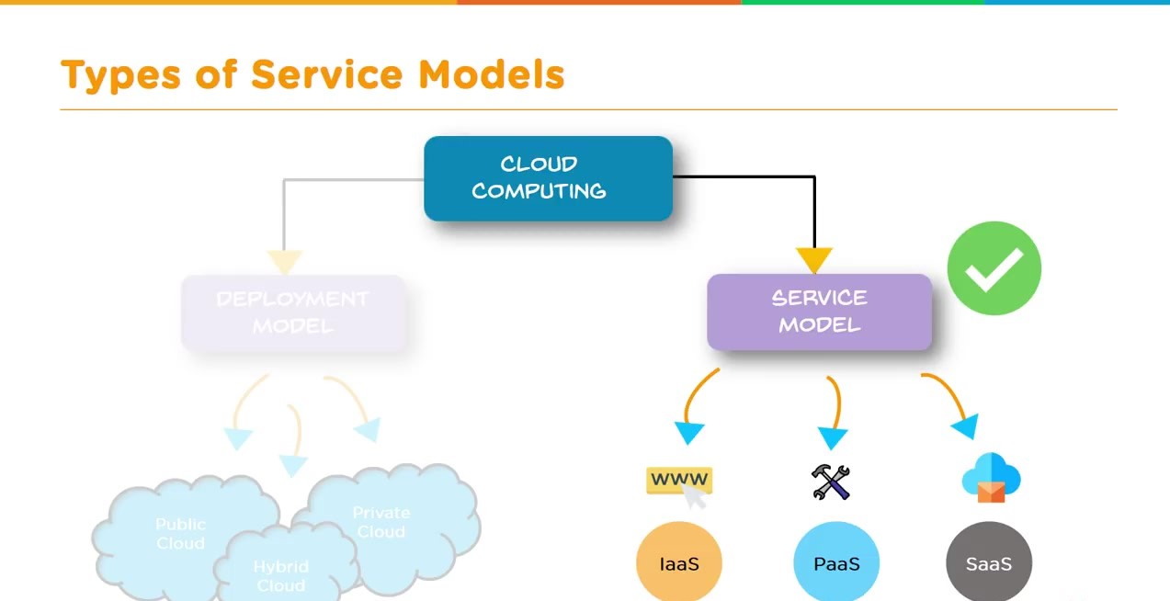

Slide 17
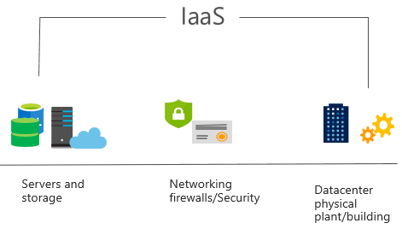
Define Infrastructure as a Service (IaaS)
Build pay-as-you-go IT infrastructure by renting servers, virtual machines, storage, networks, and operating systems from a cloud provider.
Notes:
For more information on IaaS, visit https://azure.microsoft.com/en-us/overview/what-is-iaas/
Most basic cloud computing services category.
Build pay-as-you-go IT infrastructure by renting servers, virtual machines, storage, networks, and operating systems from a cloud provider.
Instant computing infrastructure, provisioned and managed over the internet.

Slide 18
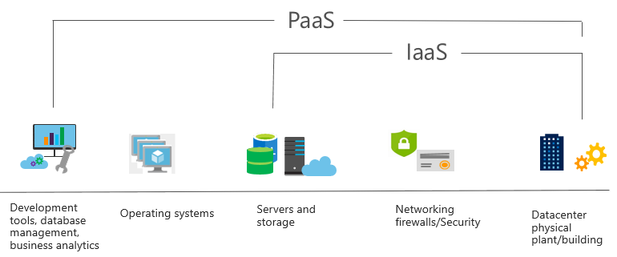
Define Platform as a Service (PaaS)
Provides environment for building, testing, and deploying software applications; without focusing on managing underlying infrastructure.
Notes:
For more information on PaaS, see https://azure.microsoft.com/en-us/overview/what-is-paas/
Provides environment for building, testing, and deploying software applications.
Helps create applications quickly, without focusing on managing underlying infrastructure.

Slide 19
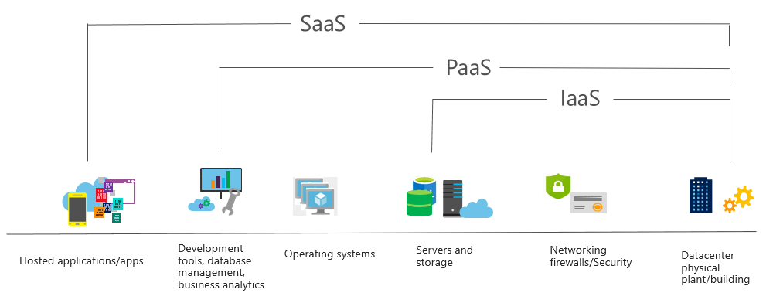
Define Software as a Service (SaaS)
Users connect to and use cloud-based apps over the internet: for example, Microsoft Office 365, email, and calendars.
Notes:
Common usage scenarios:
Examples of Microsoft SaaS services include Microsoft Office 365, Skype, and Microsoft Dynamics CRM Online.
For more information on SaaS, see https://azure.microsoft.com/en-us/overview/what-is-saas/

Slide 20
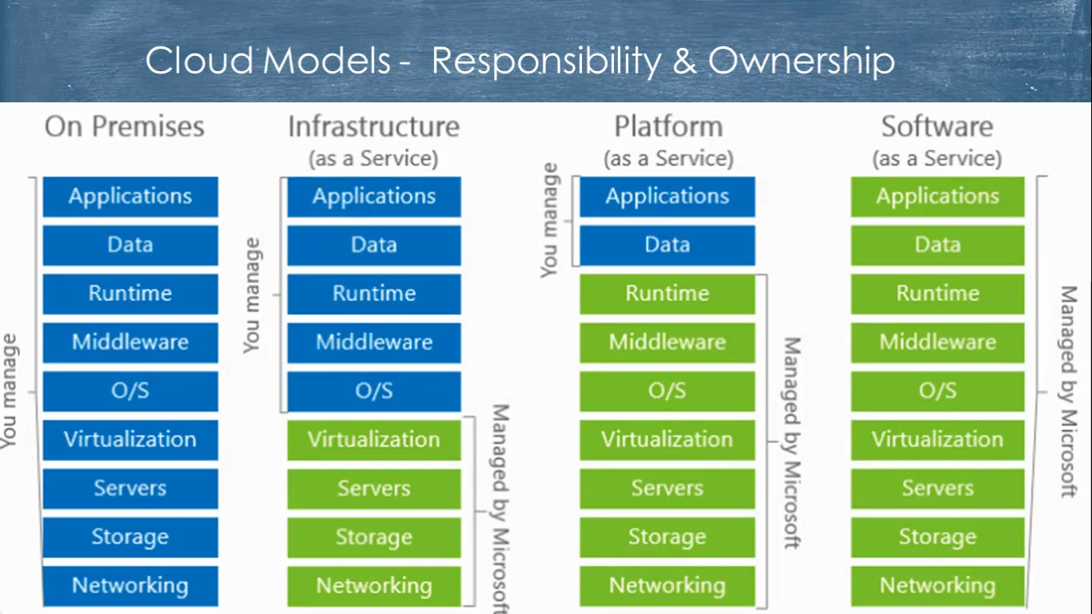

Slide 21
Cloud Business Advantages
Cloud computing offers enterprise decision makers:
    Optimized resource utilization” Enterprises typically use a small percentage of their server computing resources. By using a cloud solution, resources become available when needed and are liberated when no longer needed; there is near-perfect alignment with actual demand.
    Cost savings” Increased server utilization plus the transition of computational capability from acquired and maintained computers to rented cloud services change the computing cost paradigm from a capital expenditure (CAPEX) to an operational expenditure (OPEX), with potentially significant up-front and total cost savings. Flexible, on-demand services enable solution testing without significant capital investments and provide transparency of usage charges to drive behavioral change within enterprises.
    Better responsiveness” On-demand, agile, scalable and flexible services that can be implemented quickly provide enterprises with the ability to respond to changing requirements and peak periods.
    Reduced time for implementation” Cloud computing provides processing power and data storage as needed and at the capacity needed, in near-real time, not requiring the weeks or months (or CAPEX) that accrue when a new business initiative is brought online ina traditional IT enterprise.
    Resilience” A large, highly resilient environment reduces the potential for system failure. The failure of one component of a cloud- based system has less impact on overall service availability and reduces the risk of downtime.

Slide 22
Big Data
Big Data is a collection of data that is huge in volume, yet growing exponentially with time. It is a data with so large size and complexity that none of traditional data management tools can store it or process it efficiently
Big Data analytics examples includes stock exchanges, social media sites
Big Data could be 1) Structured, 2) Unstructured, 3) Semi-structured
Improved customer service, better operational efficiency, Better Decision Making are few advantages of Big data
What is an Example of Big Data?
  The New York Stock Exchange is an example of Big Data that generates about one terabyte of new trade data per day.
  Social Media .The statistic shows that 500+terabytes of new data get ingested into the databases of social media site Facebook, every day. This data is mainly generated in terms of photo and video uploads, message exchanges, putting comments etc.

Slide 23
Some of the challenges enterprises commonly face associated with big data include the following:
  Data ownership is often not clearly defined
  Marketing or other departments can obtain the data needed by their business units without considering the costs or risk associated with using the data.
  Evolving regulatory requirements impact data governance. The lack of a clear data governance structure makes it harder to respond to emerging or changing international data laws.
  Siloed departmental and organizational structures result in disaggregated datasets and data analytics challenges.
  Data flood can result in quality problems. Big data is of no value if it cannot contribute to better business decision making.
  Lack of skilled staff to conduct data analysis creates a barrier to effective data governance. A good working knowledge of data analytics becomes critical to the success of an enterprise

Slide 24
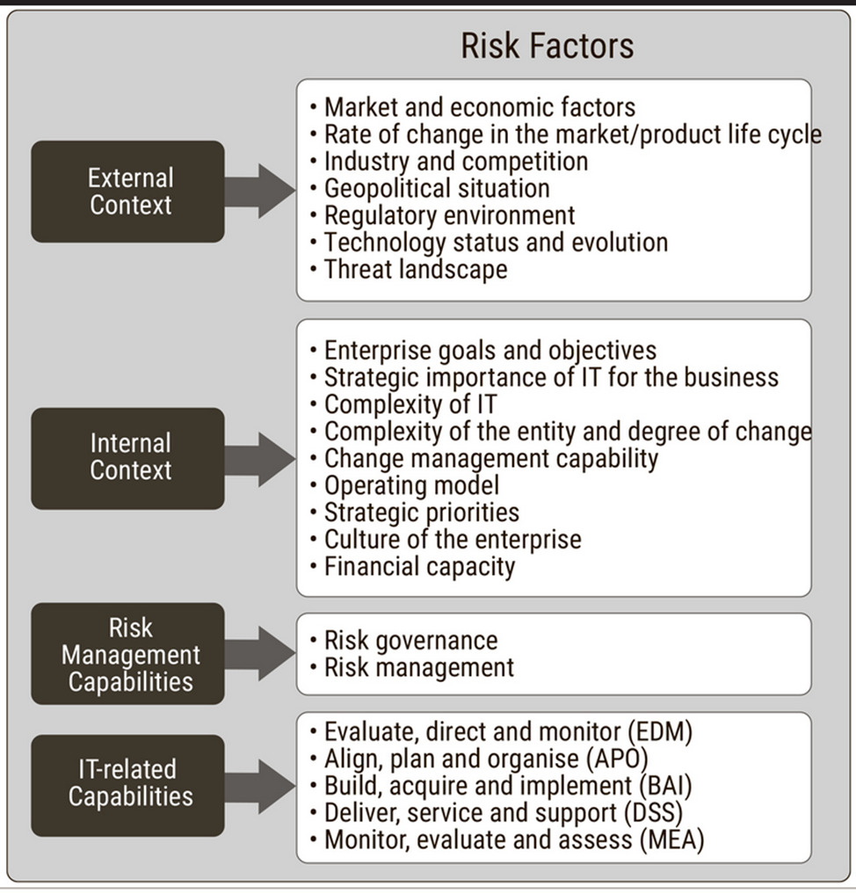
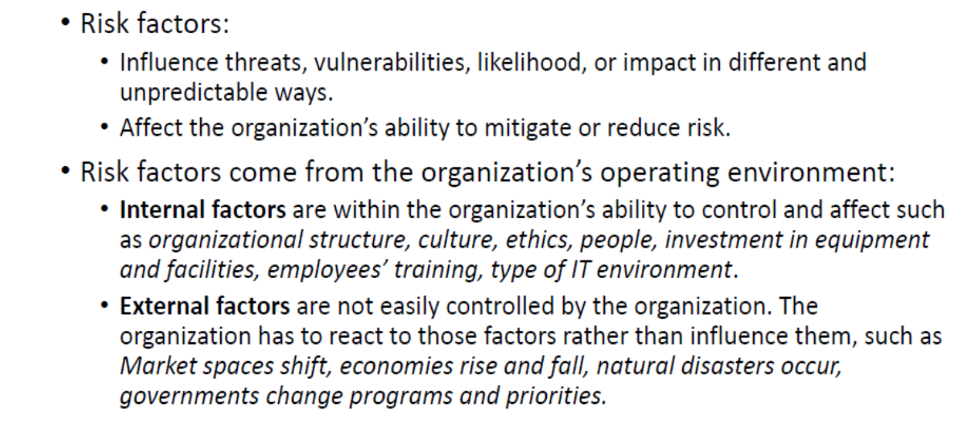
Risk Factors

Slide 25
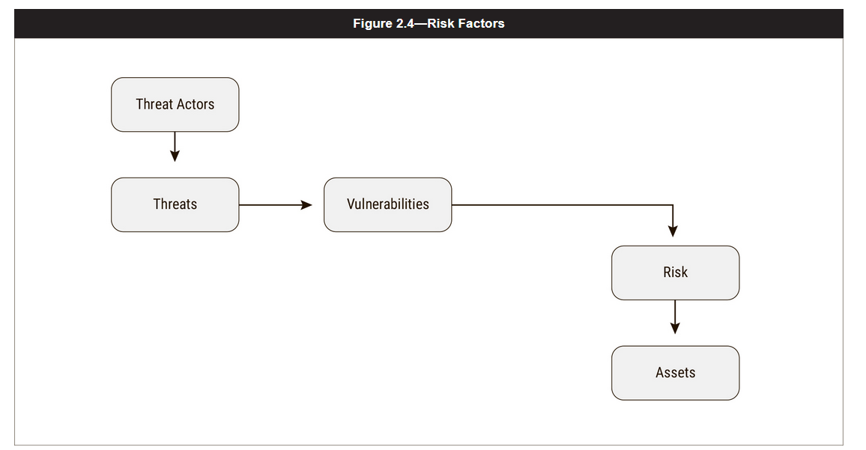
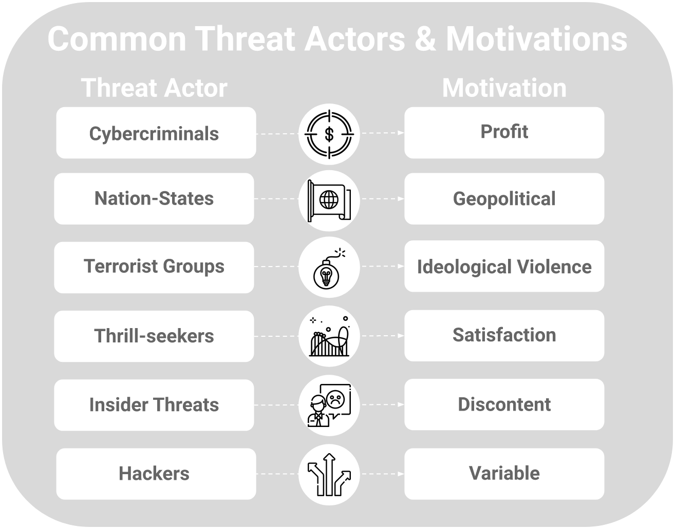
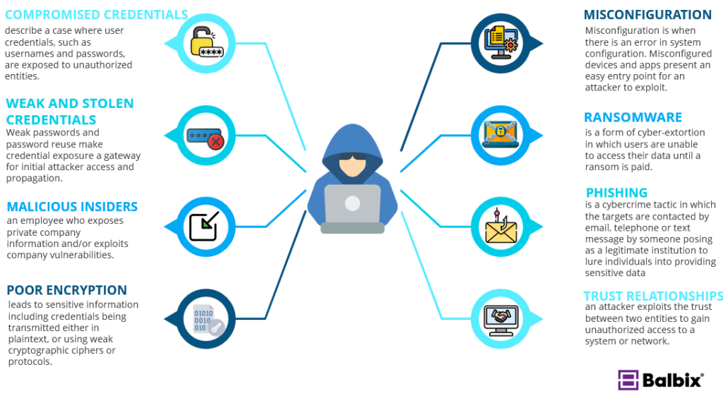
As shown in Figure 2.4,
A Threats are actions that can result in risk to a system.
A threat actor is the source of the threat on the system.
A Threat Vectors are the methods that threat actors use to attack a vulnerability in a system in order to achieve their objective.
AThreat Agent is the individual or group that acts, or has the power to, exploit a vulnerability or conduct other damaging activities.
Examples of threat agents are malicious hackers, organized crime, insiders (including system administrators and developers), terrorists
Threat actors that lack the ability to act may not pose a significant risk.
Similarly, properly protected assets that are not vulnerable to threat events present no risk from attack.
For example, if a virus has been written to exploit a vulnerability on a system, the virus can only have an impact if the system has not been patched to eliminate the vulnerability. After the patch has been applied, the virus poses no threat to the system.
Common Cyber Attack Vectors

Slide 26
  The first step in avoiding a threat is identifying it.
  Knowledge of threats and the motivations, strategy and techniques of those who perpetrate threats is key, so that a threat may be managed before it becomes reality.
  An enterprise needs to know its own weaknesses, strengths, vulnerabilities and the gaps in the security fabric.
  Any gaps in the security fabric can easily be exploited.
  The better the risk practitioner understands the mind of the attacker or the source of the threat, the more effective the risk management activities will be in countering the threat.
  The threat and vulnerability landscape is always changing.
  The risk practitioner must proactively seek out threats, vulnerabilities and controls through regular assessments, testing, observation and analysis in order to be able to identify risk.
  Risk logs (known as risk register) can be used as a tool to manage the risk generated during the identification process.
  Because risk is cyclical and ongoing, risk logs are living documents, which need to be updated to ensure the entire enterprise understands how risk is being approached and managed.

Slide 27
Integration of Risk Management into Other Processes
the concept of risk should be integrated into several IT and business processes in an organization.

Slide 32
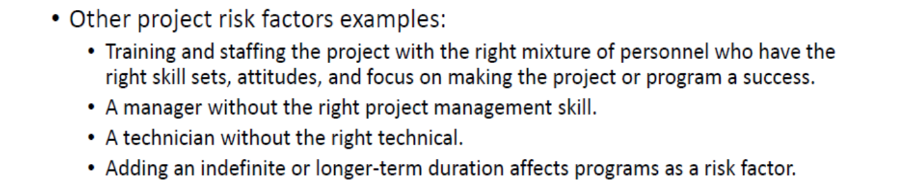

Slide 39
An SDLC (software development life cycle) is a big-picture breakdown of all the steps involved in software creation (planning, coding, testing, deploying, etc.).
Companies define custom SDLCs to create a predictable, iterative framework that guides the team through all major stages of development.

Slide 40
  An SDLC approach is made up of a number of distinct phases each with a defined set of activities and outcomes.
  Each phase has defined goals and activities to perform with assigned responsibilities, expected outcomes and target completion dates.

Slide 41
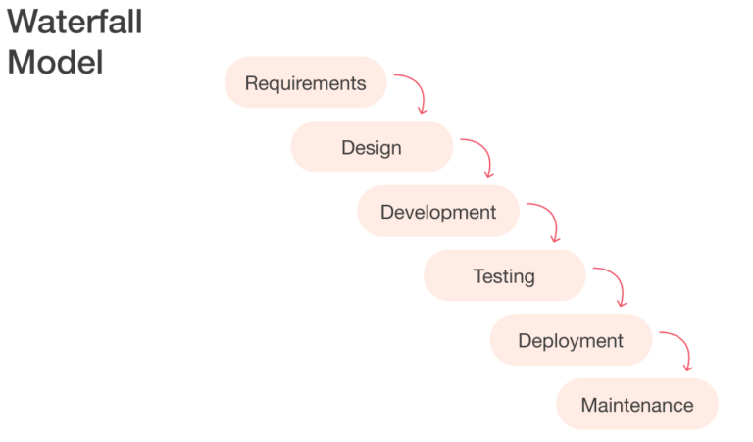
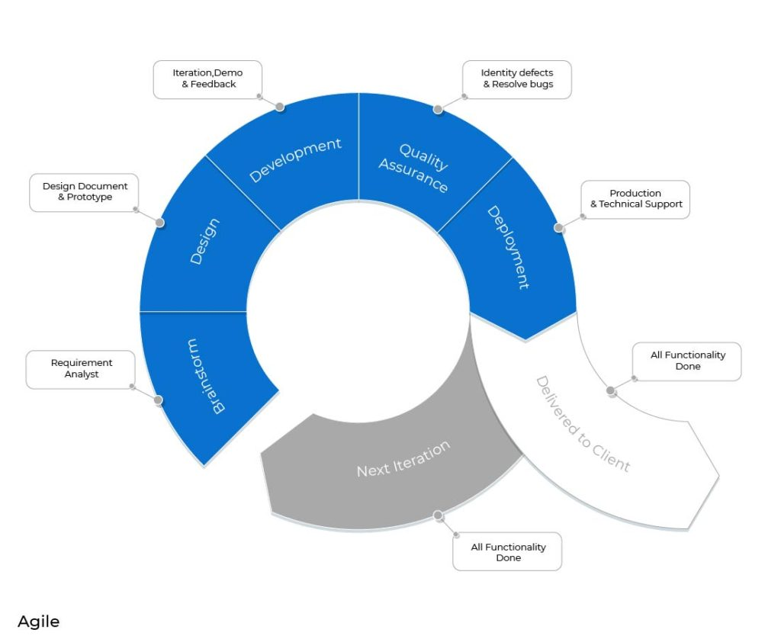
Popular Software Development Life Cycle Models
The waterfall is the oldest SDLC methodology used for the Software Development Life Cycle.
As per the waterfall model, the software development process goes through all the software development lifecycle phases without any overlapping.
It is a linear-sequential life cycle model, so any stage in the development process can begin only after completing the previous one.
Teams are mainly large, and everyone on the team works within their silos.
The development team enters the coding phase of the software once the entire architecture, data structures, and functional software designs are ready. Only after then integration and validation will get started.
Today, according to StackOverflow, 85% of developers use Agile approaches while working on software products.
The Agile SDLC model presupposes breaking the development into smaller iterations (so-called sprints) rather than building a product as an integral. The sprints usually last 2-4 weeks and focus on product increment.
Agile is gradually becoming a mainstream technology expanding its reach beyond coding.
It is more focused on an interactive approach as it enables clients, developers, and testers to work together throughout the entire project.
The Agile model allows you to promptly receive up-to-date feedback from the users and adjust the development according to it.

